Slide 1

Blockchain
Sunitha R
Department of Computer Science and Engineering

Slide 2

Blockchain
BLOCKCHAIN-AS-A-SERVICE (BAAS)
Sunitha R
Department of Computer Science and Engineering

Slide 3
Blockchain
Blockchain-as-a-service (BaaS)
Blockchain-as-a-service (BaaS) refers to third-party cloud-based infrastructure and management for companies building and operating blockchain apps.
BaaS functions like a sort of web host, running the back-end operation for a block-chain based app or platform.
BaaS may be the catalyst that leads to the widespread adoption of blockchain technology.

Slide 4
Blockchain
Blockchain-as-a-service (BaaS)
Blockchain-as-a-Service (BaaS) is the third-party creation and management of cloud-based networks for companies in the business of building blockchain applications.
These third-party services are a relatively new development in the growing field of blockchain technology.
The business of blockchain technology has moved well beyond its best-known use in cryptocurrency transactions and has broadened to address secure transactions of all kinds.
As a result, there is a demand for hosting services.

Slide 5
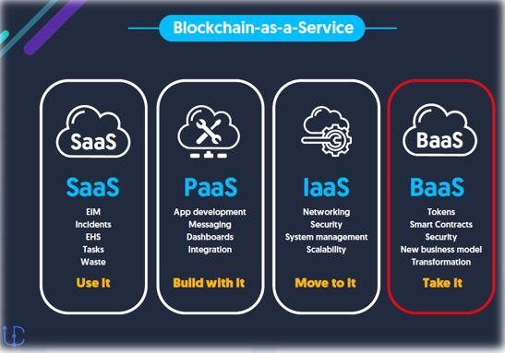
Blockchain
Blockchain-as-a-service (BaaS)

Slide 6
Blockchain
Major Players in the BaaS
Major players in the BaaS space include:
Microsoft, which partnered with ConsenSys to introduce Ethereum blockchain-as-a-service on Microsoft Azure in 2015.
Amazon, which has introduced Amazon Managed Blockchain, a service that "makes it easy to create and manage scalable blockchain networks" using open source frameworks including Ethereum and Hyperledger Fabric
R3, a consortium of global financial institutions that produced a distributed financial ledger called Corda
PayStand, which specializes in sending and receiving payments between companies.

Slide 7
Blockchain
BaaS
Why Do Organizations Need Blockchain as a Service (BaaS)?

Slide 8
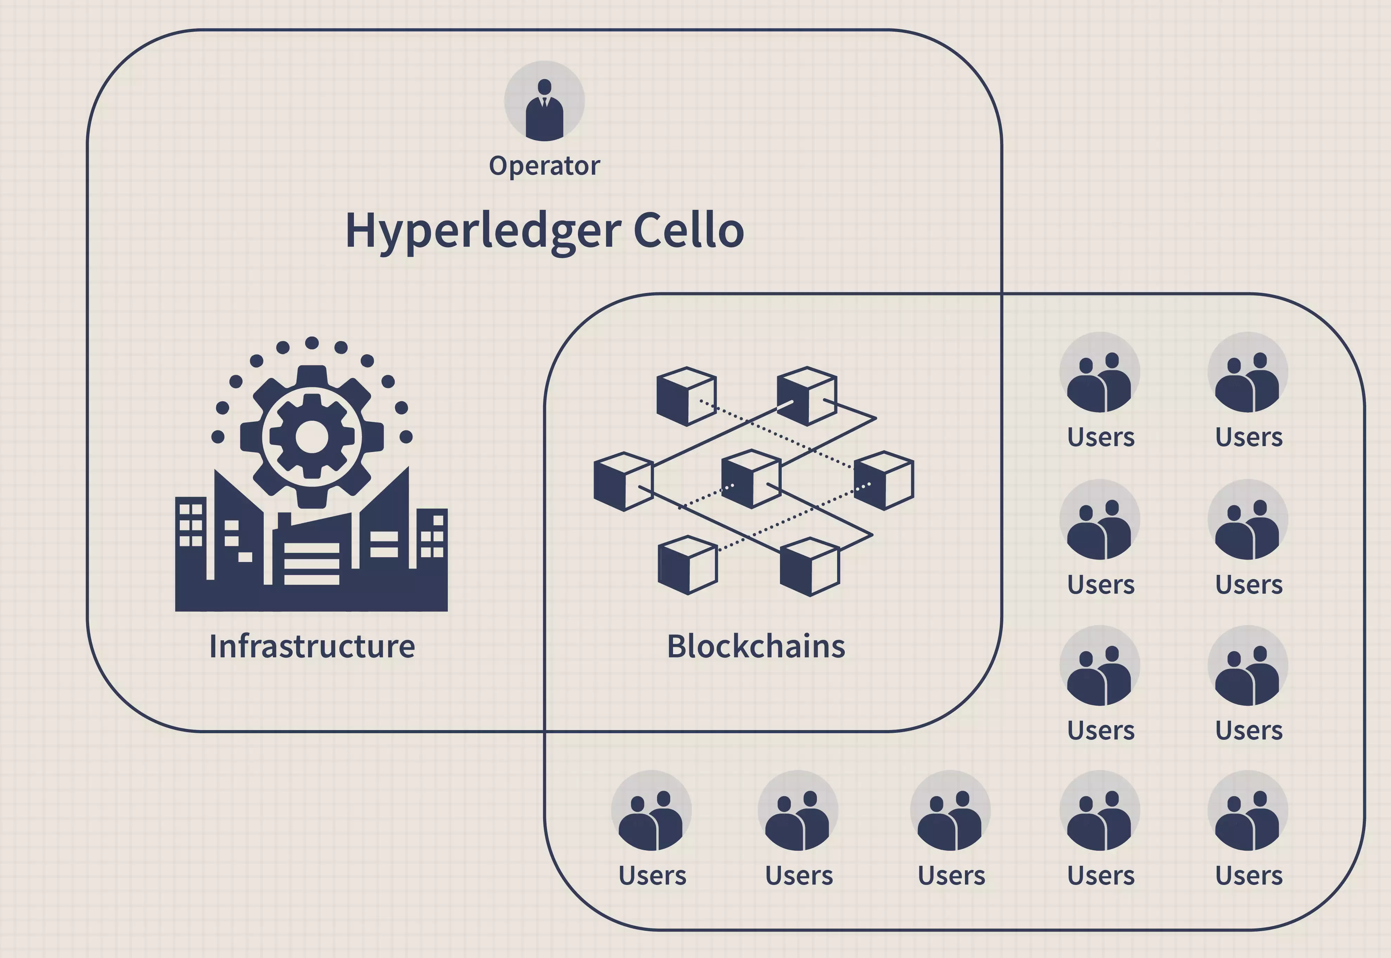
Blockchain
HOW BaaS WORKS?

Slide 9
Blockchain
BaaS
How to Handle Security Concerns Related to BaaS?

Slide 10
Blockchain
Criteria for Selecting a Blockchain as a Service Partner
Prior experience in setting up Blockchain infrastructure/Market Credential
Commitment to Quality
Security Assurance
Choice of Operating Systems
Ease of Use
Pricing and Support

Slide 11
Blockchain
Factors that can help to choose the right BaaS Platform
Smart Contracts Integration
IAM(Identity Access Management) Platforms
Different Runtimes and Frameworks
Identity-based Consensus Mechanisms

Slide 12
Blockchain
ADVANTAGEOUS
Flexible and Efficient
Open and Easy
Privacy Protection and Security
Cost-Effective

Slide 13
Blockchain
DISADVANTAGEOUS
Limited In-depth Knowledge
Lack of Visibility and Control
Data Compliance Challenges
Business Continuity

Slide 14
Blockchain
SUPPLEMENTARY READINGS
https://ieeexplore.ieee.org/stamp/stamp.jsp?arnumber=8406562

Slide 15
THANK YOU
Prof.Sunitha R
Department of Computer Science and Engineering
sunithar@pes.edu

